Slide 1
J.A.R.V.I.S CHATBOT
A CSCI-201 PROJECT

Slide 3
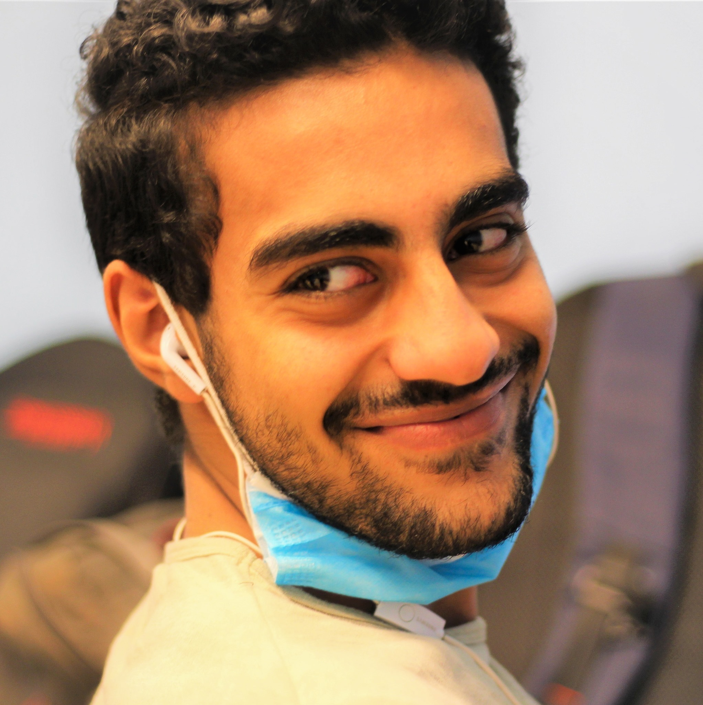
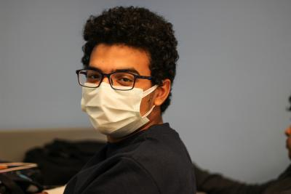
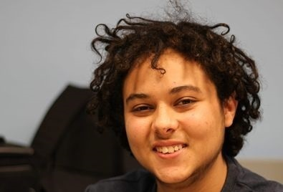
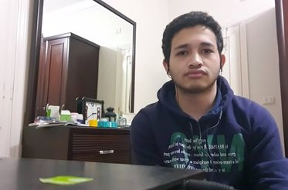
THE TEAM
Youssef Hisham Abd elwahab 202000543
Anas Ahmed Hassan Sayed 202000005
Eslam Ahmed Mohamed
202000039
Ziad Ahmed ElKady
202001598

Slide 4
TABLE OF CONTENTS
01
04
About the Project
Sneak Peek
03
06
Project Goals
Our Team
A Multifunctional Chatbot
that can simulate a conversation (or a chat) with a user in natural language through messaging
Our goal is to make Jarvis a more often used bot that helps people around the world and to stop boredom
Eslam ,Anas ,Zeyad ,Youssef
Has been working hard each night to make Jarvis possible

Slide 5

OUR PROJECT
J.A.R.V.I.S
By Working and studying hard our team with the cheering of our professors and friends accomplished the project successfully, our project is about a multifunctional chatbot that can do a lot of things like recommending a movie, play solve math equations or encrypt words, and many more to come!

Slide 6
WHAT WE ARE WORKING ON
SECURE
ACCESSIBLE
FAST AND RELIABLE
It is secure and no one can access your data from it
J.A.R.V.S
Can Be Accessed From any computer or laptop
You can trust Jarvis at doing his job with his fast response

Slide 7
NOW
BASIC DESIGN
PROGRAMMING MISTAKES
LACK OF ADAPTABILITY

Slide 8
FUTURE
BRANDING
POSITIONING
ADAPTABILITY

Slide 9
OUR GOALS
EXPANSION
POSITIONING
USABILITY
To make it compatible with different devices
To be the number one in the world
Make it easier for children and other people to use

Slide 10
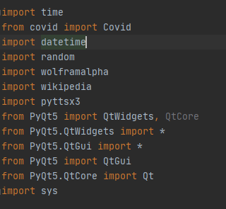
libraries Imported

Slide 11
How it works?
Start
Str userInput
L=userInput.upper().split()
Int i = 0
i = len(L)
L[0]=“Movie”
L[0]=“Corona”
No
No
i++
yes
yes
yes
Search()
Recommend_movie()
Covid()
End

Slide 12
Instruction To Use J.A.R.V.I.S
First install the needed Libraries in the previous slide then ,
Try asking Jarvis this stuff:
Encode a message using ceaser cypher
Decode a message using ceaser cypher
Covid-19 information of every country
Recommend a movie
Search or calculate anything (Jarvis will search for the answer on Wolfram alpha or (Wikipedia)
Ask it questions such as: Rhonda has 12 marbles more than Douglas. Douglas has 6 marbles more than Bertha. Rhonda has twice as many marbles as Bertha has. How many marbles does Douglas have?

Slide 13
PROJECT STAGES
STEP 2
STEP 1
STEP 3
Learning courses that we are going to need and asking our professors to give us ideas of things to put in jarvis
Coming up with the idea of Jarvis
Performing what we learned

Slide 14
OUR TIMELINE
WEEK 1
WEEK 3
IDEA
FINAL RELEASE
WEEK 2
WEEK 4
Prototype
Beta Version
Work
Final Release

Slide 15
THANKS!

